Slide 1
Social Security Representative Payees: Judicial Training Guide
NOVEMBER 2016

Slide 2
SSA Collaboration with WINGS Guardianship Groups
Working Interdisciplinary Network of Guardianship Stakeholders (WINGS)
16 WINGS groups
SSA designee as key stakeholder

Slide 3
Objectives of Training Guide
Orient judges and court staff to SSA representative payee program
Highlight similarities and differences between representative payee program and guardianship
Alert courts to possible misuse of Social Security benefits
Better serve individuals who have both payee and guardian
Enhance collaboration between courts and SSA

Slide 4
Training Agenda
Overview of SSA benefit programs
Comparison of guardian and representative payee systems
Representative payee duties
Guardianship fees from SSA benefits
Court/SSA best practices for coordination

Slide 5
SSA’S Major Benefit Programs
Retirement, Survivors & Disability Insurance
(Social Security)
Supplemental Security Income (SSI)

Slide 6
Social Security
Protects workers and their families from loss of earnings due to one of the following reasons:
Death
Disability
Retirement

Slide 7
Supplemental Security Income (SSI)
Needs-based program for:
Age 65 or older OR
Blind or Disabled; and
Limited income and resources

Slide 8
Compare: Initiate
Petition to court
Any interested person
Application to SSA
Proposed payee
Beneficiary
Third party referral

Slide 9
Compare: Need
Statutory definition of incapacity
Finding based on clear & convincing evidence
Incapacity to manage or direct the management of payments
Court finding of legal incompetency
Most children under age 18 unless emancipated

Slide 10
Compare: Process
Notice
Medical statement; possible visitor or guardian ad litem investigation
Possible appointment of counsel
Hearing, testimony, possible presence of person
Court order
Reviewing SSA field office investigates and reviews legal, medical and lay evidence

Slide 11
Compare: Selection
Nominee in petition
Statutory preference
Family
Corporate
Professional
Public
Volunteer
Possible background check
Nominee in application
Regulation guidance
Custodial Parent or Spouse
Legal guardian
Relative
Friend
Public or nonprofit agency
Background check, if applicable

Slide 12
Compare:Authority
Full or limited
Property
Person
Both property and person
Only SSA benefit
“A payee has no legal authority to manage non-Social Security income or medical matters. A representative payee, however, may need to help a beneficiary get medical services or treatment.”
– SSA Guide for Representative Payees

Slide 13
Compare: Reporting
Inventory
Accounting
Possible guardianship plan
Status report
Annual Accounting
Expenditures
Conserved funds
Report changes that may affect the beneficiary’s entitlement or amount of payment
(Please see slide 19 for complete list)

Slide 14
Compare: Last Resort
Public guardianship program in many states or localities
A private institution operated for profit and licensed under State law, which has custody of the beneficiary; and
Persons other than above who are able and willing to serve as a payee for a beneficiary; e.g., members of community groups or organizations who volunteer to serve as payee for a beneficiary

Slide 15
Compare: Financial Management
Fiduciary duty
Possible bond; restricted accounts
Marshal assets
Separate bank account
Possible statutory guidance on investment
Possible court approval of real estate and asset sale
Account to court
Fiduciary duty
Maintain current needs
Special bank account
Savings account
Guidance on creditors’ claims
No contracts
Personal responsibility for misused funds

Slide 16
Compare: Participation
Notice of hearing
May attend hearing
Appeal to higher state court
May file for termination & restoration of rights
Advance notice of need for a payee
Opportunity to protest
Notice of payee appointment
Appeal to SSA

Slide 17
Who Needs a Representative Payee?
Adults incapable of managing or directing the management of Social Security benefits
Most children under age of 18
Adults declared by court as incompetent

Slide 18
Duties of a Representative Payee
Determine basic needs and use benefit for those needs
Ensure that beneficiaries who reside in a facility receive a minimum personal needs allowance of $30 per for personal needs expenses
Save benefits not needed for current needs
Keep accurate written records of what benefits received and how spent
Provide the Annual Representative Payee Accounting Report and make supporting documentation available upon SSA’s request
Report changes that may affect payments

Slide 19
Representative Payee Reporting Requirements
Payee must report changes
Beneficiary moves
Beneficiary starts or stops working
Beneficiary’s medical condition improves
Beneficiary marries
Beneficiary no longer needs a payee
Beneficiary dies
Rep payee can no longer serve

Slide 20
Representative Payee Accounting
Separately identify
Amount spent on beneficiary’s basic needs and personal items
Amount saved, if any
Submit
By Mail
Online - www.socialsecurity.gov/payee/form/index.htm

Slide 21
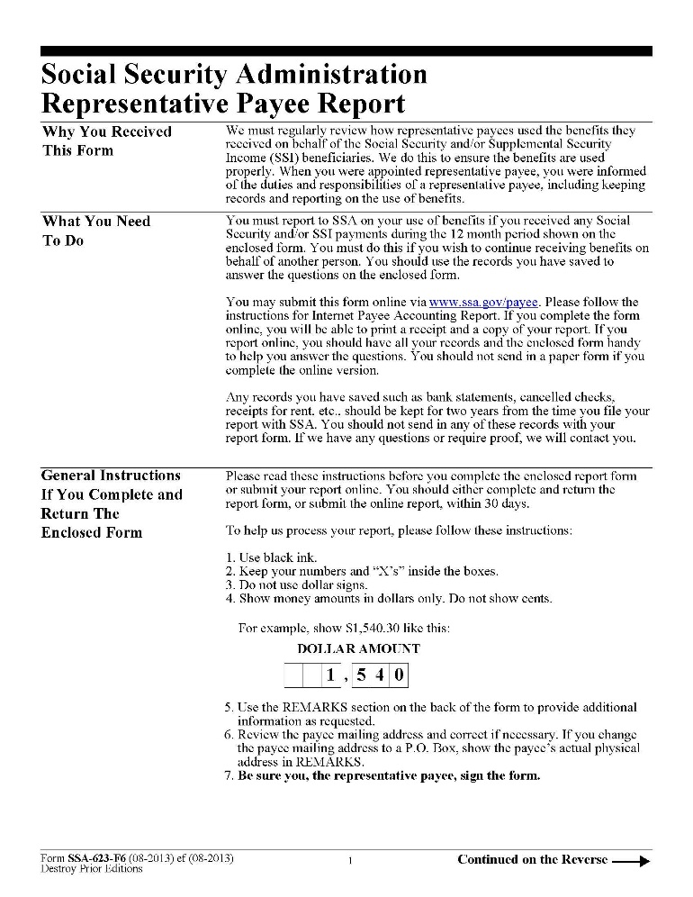
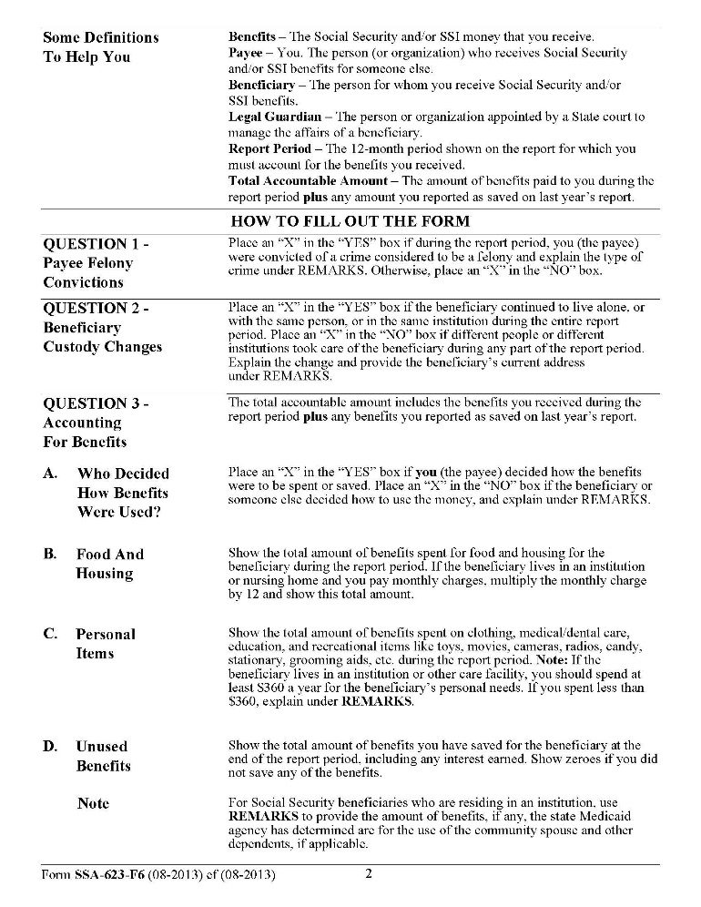
Representative Payee Accounting Form
(Pages 1 - 2)

Slide 22
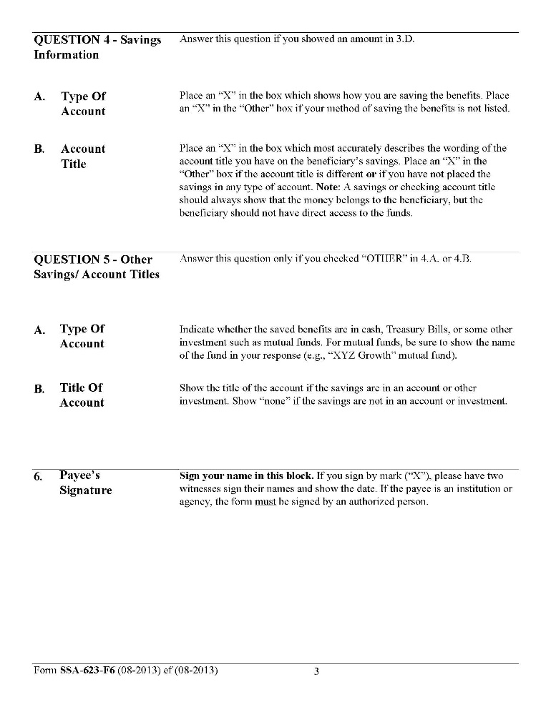
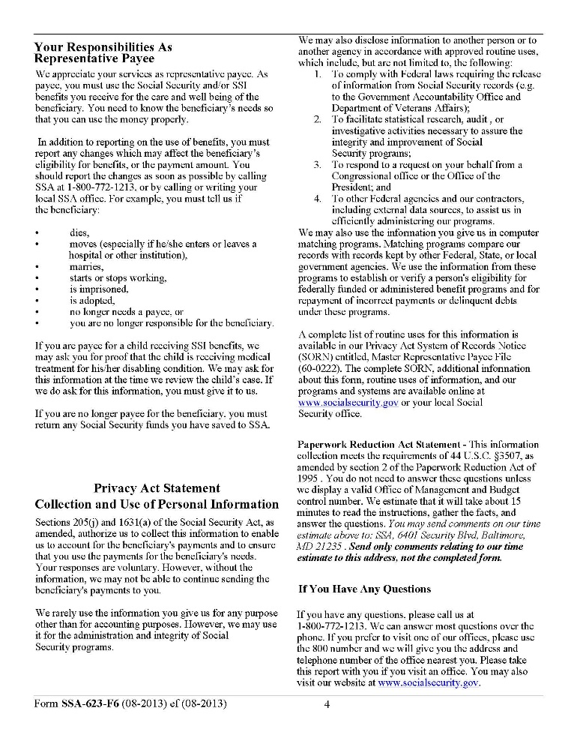
Representative Payee Accounting Form
(Pages 3 - 4)

Slide 23
Failure of Representative Payee to Report
If the payee does not respond or cooperate, SSA may:
Change payee or
Initiate direct payment to beneficiary
SSA field office must:
Evaluate current payee for continued suitability
Consider if beneficiary is capable of managing his or her own benefits
Document any suspected misuse or fraud

Slide 24
Payee Misuse of Beneficiary Funds
Rep payees may not:
Use beneficiary’s benefits for the rep payee’s own personal expenses
Put beneficiary funds in rep payee’s or another person's account
Keep conserved funds after no longer rep payee
Charge beneficiary for services unless authorized by SSA

Slide 25
Reporting Potential Misuse by Representative Payees
If you suspect a representative payee has misused SSA benefits, contact SSA OIG Fraud Hotline: oig.ssa.gov/report-fraud-waste-or-abuse/fraud-waste-and-abuse
Provide identifying information for rep payee and beneficiary
Names
Social Security numbers
Date of birth
Provide details of when, how, and where

Slide 26
Fee-for-Services Representative Payees
Fee-for-Service Payee (FFS) is an organization authorized by SSA to receive payment for their payee services
To qualify as a FFS payee, the organization must:
Be a state/local government agencies or a bonded and licensed community based non-profit social service organization
Regularly serve at least five beneficiaries
Generally not be a creditor of the beneficiary
Request approval in writing
Receives notice of approval from SSA before collecting fee

Slide 27
FFS Organizational Payee Payment
FFS organizational payees can collect the lesser of 10% of monthly benefit amount or
$41 (2017) for beneficiaries without listed diagnosis code involving drug addiction or alcoholism (DAA),
$78 (2017) for beneficiaries with a listed diagnosis code involving DAA

Slide 28
Fee-for-Services Representative Payees
An organizational rep payee cannot collect the fee for service that SSA otherwise authorized if the organizational rep payee is already being compensated by court/guardianship fees for rep payee services (and the amount of compensation from court/guardianship fees for rep payee services equals or exceeds the fee for service that SSA otherwise authorized)

Slide 29
Representative Payee Monitoring-Site Reviews
In addition to annual accounting, SSA monitors representative payee performance by conducting site reviews.
The SSA Act requires SSA to periodically conduct an onsite review of:
Individual payees serving 15 or more beneficiaries or recipients;
Organizational payees serving 50 or more beneficiaries or recipients;
Fee-for-Service (FFS) payees; and
State mental hospitals participating in our on-site review program.
SSA also conducts discretionary site reviews of payees, including:
Organizational payees serving 49 or fewer beneficiaries or recipients;
Individual payees serving 14 or fewer beneficiaries or recipients; and
Reviews triggered by reports of potential problems with the representative payee.
A site review includes:
Face-to face interview with the payee and, in most cases, a visit to the payee’s location;
Interviews with a sample of beneficiaries; and
Examination of the financial records and supporting documentation for each sampled beneficiary.

Slide 30
When SSA Benefit Can be Used for Guardian Costs & Fees
Beneficiary’s funds may be used for customary guardianship costs (or proceedings) and court-appointed fees, if :
Guardianship appears to be in the beneficiary’s best interests
Beneficiary’s personal needs are met, and
Beneficiary’s funds would not be depleted by the guardianship costs

Slide 31
When SSA Benefit CANNOT be Used for Guardian Costs & Fees
Guardianship costs and fees are included as part of the state’s support obligation to the beneficiary
Cost or fees relate to an unsuccessful guardianship petition
Beneficiary’s funds will be depleted by the guardianship costs to the point where personal needs are unmet

Slide 32
Promising Court Practices to Coordinate With SSA Representative Payee System
General Court Practices
Consider representative payee as option to avoid need for guardianship of property if no other income or assets
Require guardianship petition to include rep payee status and contact information for payee
Instruct guardian ad litem, court visitor, investigators to inquire about rep payee status
Alert local SSA office of appointment of guardian for person receiving SSA benefits

Slide 33
Promising Court Practices to Coordinate With SSA Representative Payee System
Court practices when guardian is also rep payee
Identify cases where there is dual role
Identify cases in which guardian seeks fee from a bank account containing SSA benefits
Notify SSA of any changes to status of guardian who is also representative payee
Report suspected abuse/exploitation by guardian who is also rep payee to
Local SSA office
SSA Office of Inspector General
Local adult protective services

Slide 34
Promising Court Practices to Coordinate With SSA Representative Payee System
Court – SSA systemic coordination practices
Judges & court staff meet regularly with designated SSA representative payees to address coordination and training needs
Recruit and encourage attorney volunteers to serve pro bono as representative payees

Slide 35
Key SSA Resources for Courts
SSA Regional Communications Directors in the federal regions at www.socialsecurity.gov/agency/rcds.html
SSA Guide for Representative Payees at www.socialsecurity.gov/pubs/EN-05-10076.pdf
SSA Guide for Organizational Payees at www.socialsecurity.gov/payee/NewGuide/toc.htm
U.S. Consumer Financial Protection Bureau, Managing Someone Else’s Money at www.consumerfinance.gov/managing-someone-elses-money

Slide 36
Representative Payee Guide
www.ssa.gov/pubs/EN-05-10076.pdf

